Slide 1
Comparative Eukaryotic genomics: Chloroplast, Mitochondrial and nuclear genome
- By Anandi Rebello

Slide 2
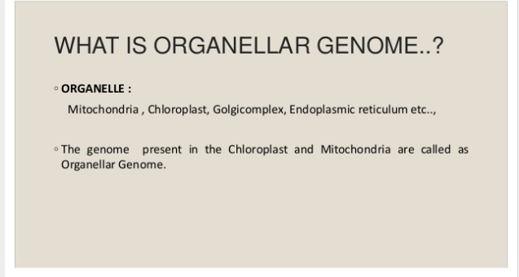

Slide 3
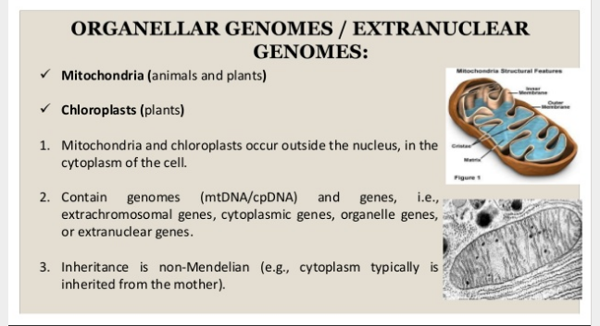

Slide 4
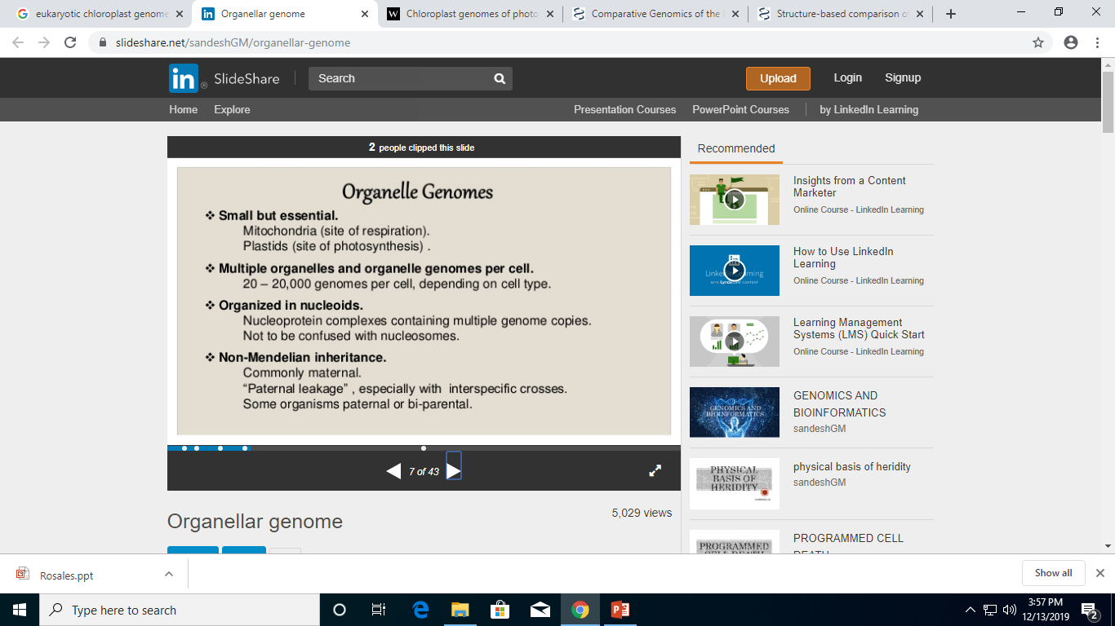

Slide 5
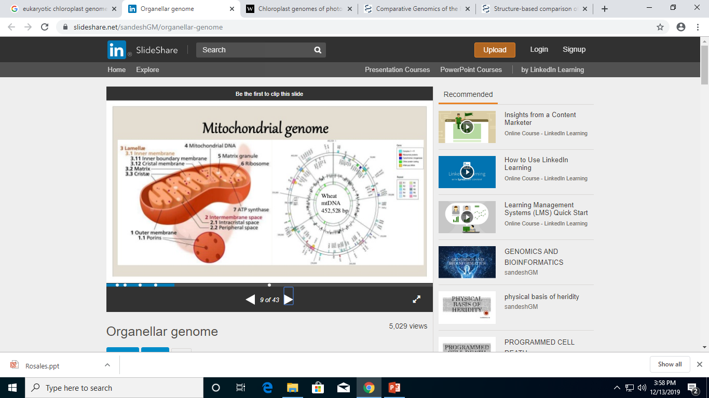

Slide 6
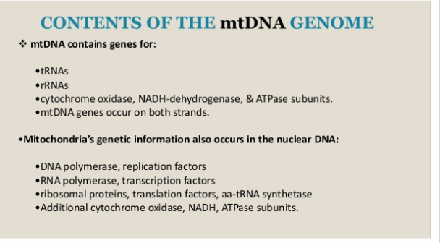

Slide 7
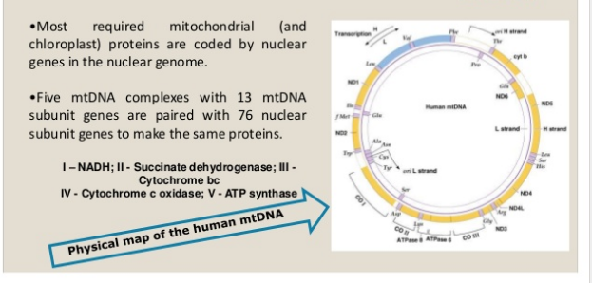

Slide 8
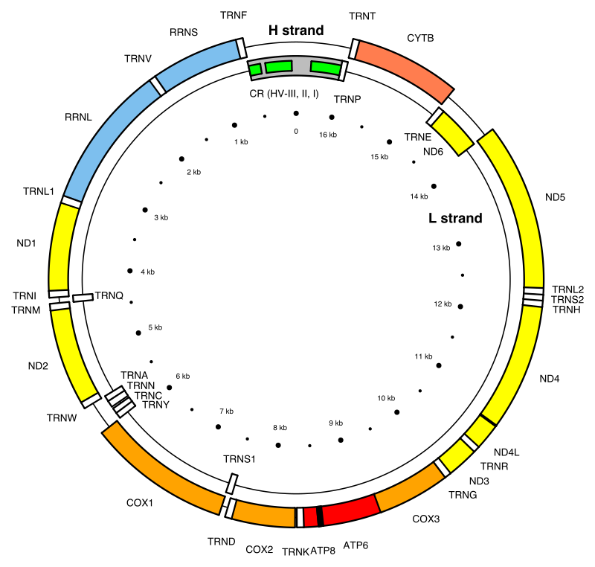
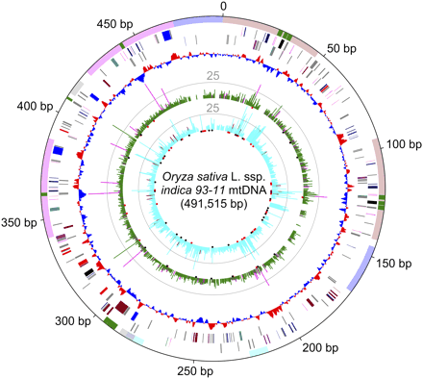
Rice mtDNA
Human mtDNA

Slide 9
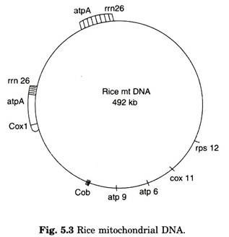
Rice mitochondrial genome is made up of 492 kb nucleotides. The complexity of rice mitochondrial genome is due to the presence of chloroplast sequences. There are 16 chloroplast fragments in rice mtDNA ranging from 32 bp to about 6.8 kb in length. Thus, results show that about 6% (22 kb) of rice mtDNA is made up of chloroplast sequence. The mitochondrial genome of rice con­tains rearranged cluster of chloroplast genes, namely, rpl2 and yrpl23-rcL-atpB-atp E-trnM- trnV. One of the palindromic repeated sequences (PRS) located in the intron of rps3 in rice mtDNA, but not in maize mtDNA. Analysis of transferred sequences of ctDNA in mtDNA of rice was evidenced in that at least three repeated sequences about 60 bp in length are present in plant. It was also found that Rice mtDNA contained at least 10 copies of the small repeated sequence.

Slide 10
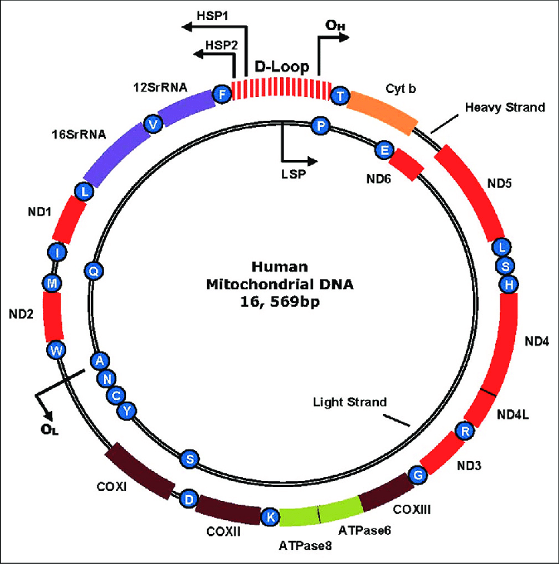
Human mitochondrial DNA is a 16,569 base pair circle of double-stranded DNA that encodes 13 essential respiratory chain subunits.
ND1-ND6 and ND4L encode seven complex I (NADH-ubiquinone oxidoreductase) subunits, CYT b encodes one subunit of complex III (ubiquinol: cytochrome c oxidoreductase), COX I-COX III encode the three major catalytic subunits of complex IV, and ATPase6 and ATPase8 encode two subunits of complex V (ATP synthase).
There are the two ribosomal RNA (12S rRNA and 16S rRNA) genes and the 22 transfer RNA genes (blue spheres, depicted by single letter amino acid code abbreviation) required for mitochondrial protein synthesis. tRNAs are: F = Phenylalanine; V = Valine; L = Leucine; I = Isoleucine; Q = Glutamine; M = Methionine; W = Tryptophan; A = Alanine; N = Asparagine; C = Cysteine; Y = Tyrosine; S = Serine; D = Aspartic acid; K = Lysine; G = Glycine; R = Arginine; H = Histidine; E = Glutamic acid; T = Threonine; P = Proline.

Slide 11
The displacement loop or noncoding control region contains the promoters for transcription of the L (LSP) and H strands (HSP1 and HS2) and the origin of replication of the H strand (O H ).
The origin of light strand replication is shown as O L

Slide 12
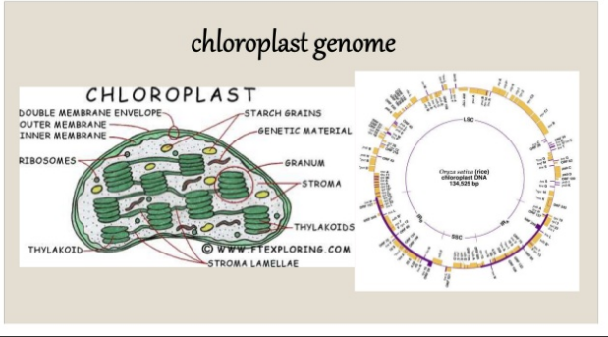

Slide 13
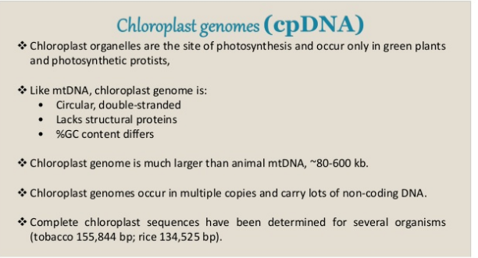

Slide 14
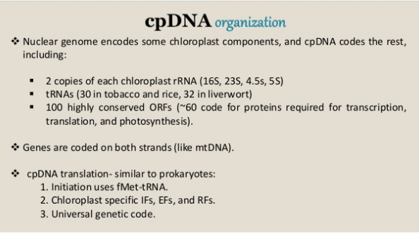

Slide 15
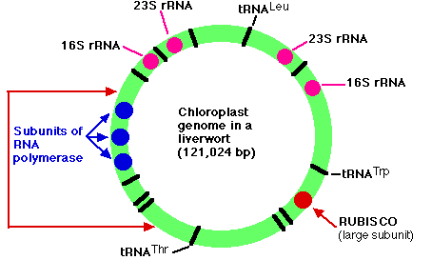

Slide 16
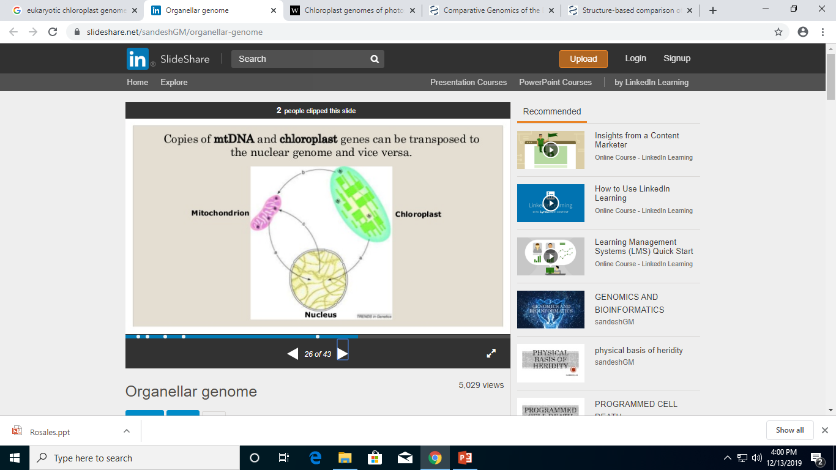
Relation between mt,cl and nuclear DNA.

Slide 17
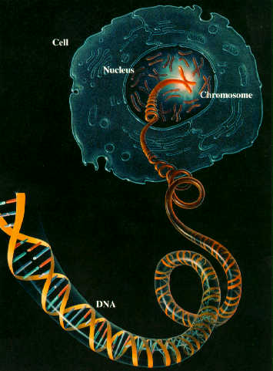
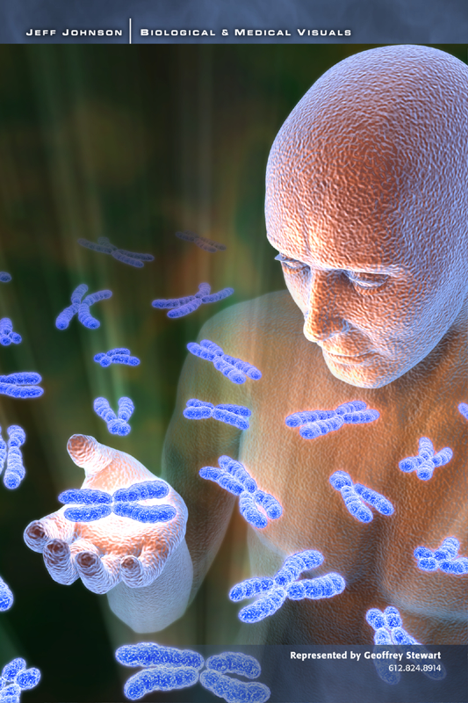
Comparative Eukaryotic Genomics

Slide 18
COMPARING THE GENOMES OF DIFFERENT ORGANISMS
Why Compare?
Need to better understand the individual genomes
To understand the functioning of individual genes
To derive a comparative study of basic functions
To better understand evolutionary processes

Slide 19

HUMAN GENOME
The Human Genome
The human genome is by far the most complex and largest genome.
Its size spans a length of about 6 feet of DNA, containing 30,000 to 40,000 genes.

Slide 20
HUMAN GENOME PROJECT
Identify the approximate genes in human DNA.
Determine the sequences of 3 billion chemical base pairs that make up human DNA.
Store this information in databases.
Improve tools for data analysis.

Slide 21
OVERVIEW OF HUMAN GENOME
The human genome contains 3164.7 million nucleotide bases ( approx. 3 billion A,C,T and G).
The average gene is made up of 3000 bases, but sizes of genes vary greatly.

Slide 22
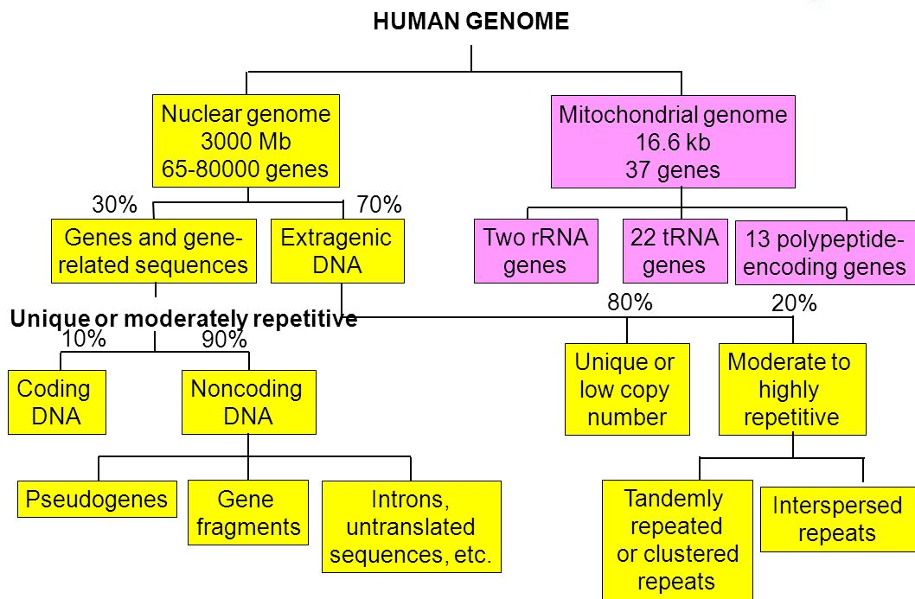
OVERVIEW OF HUMAN GENOME

Slide 23
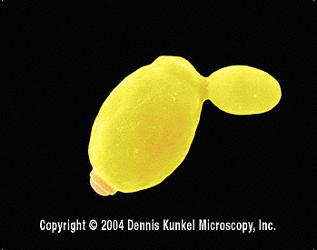
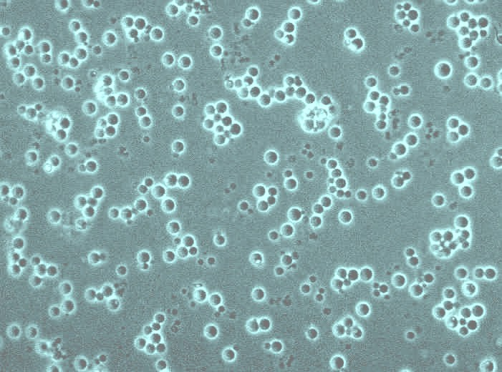
EUKARYOTIC GENOMES
Saccharomyces cerevisiae Genome
One of the most important fungal organisms used in biotechnological processes.
Considered as a model eukaryotic organism.
The first eukaryotic organism to have its entire genome sequenced.

Slide 24
Saccharomyces cerevisiae Genome
16 chromosomes (2n)
Approximate genome size – 15520 kb
5885 potential protein-coding genes.

Slide 25

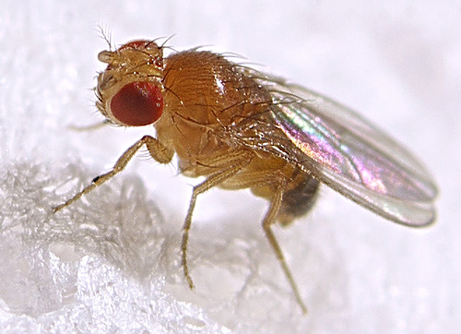
Drosophila melanogaster (Fruit Fly) Genome
Has been the most important tool for genetics studies in the twentieth century.
Second multicellular organism to have its genome sequenced.
Genome is about 180 Mb in size.
4 chromosomes (2n)
13601 predicted genes.

Slide 26
Drosophila melanogaster (Fruit Fly) Genome
Interestingly, the Drosophila genome contains genes that are similar to 177 of 289 human genes that are responsible for diseases.

Slide 27
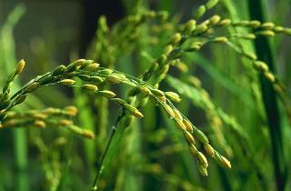
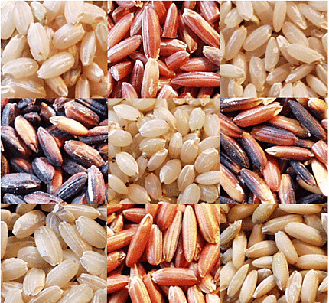
Oryza sativa L. (rice) Genome
One of the most important food crops in the world.
Scientists use rice as a model plant in cereal genomics.
24 chromosomes (2n).

Slide 28
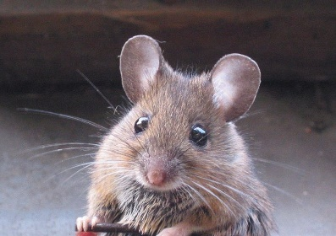
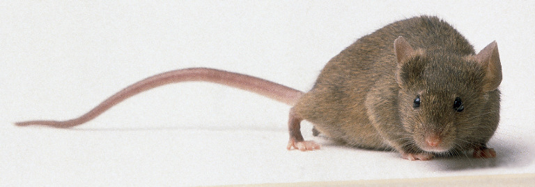
Mus musculus (Laboratory Mouse) Genome
The sequence of the mouse genome is important for understanding the contents of the human genome and it also serves as a key experimental tool for biomedical research.
20 chromosomes (2n)

Slide 29
Mus musculus (Laboratory Mouse) Genome
The draft sequence was generated by assembling the sevenfold sequence coverage from female mice of the B6 strain.
Genome size is 2.5 Gb.
Seem to contain about 30000 protein-coding genes.

Slide 30
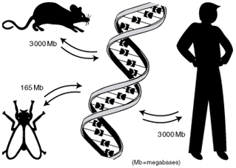
COMPARATIVE ANALYSIS OF THE HUMAN AND MOUSE GENOMES
The mouse genome is 14% smaller than the human genome.
At the nucleotide level, approximately 40% of the human genome can be aligned to the mouse genome.

Slide 31
The mouse and human genomes seem to contain about 30000 protein-coding genes.
Mouse-human sequence comparisons allow an estimate of the rate of protein evolution in mammals.

Slide 32
GENERAL GENOMIC COMPARISONS
Organism | Genome Size (Bases) | Estimated Genes
Human (Homo sapiens) | 3 billion | 30,000
Laboratory mouse (M. musculus) | 2.6 billion | 30,000
Thale cress (A. thaliana) | 100 million | 25,000
Roundworm (C. elegans) | 97 million | 19,000
Fruit fly (D. melanogaster) | 137 million | 13,000
Yeast (S. cerevisiae) | 12.1 million | 6,000
Bacterium (E. coli) | 4.6 million | 3,200
Human immunodeficiency virus (HIV) | 9700 | 9

Slide 33

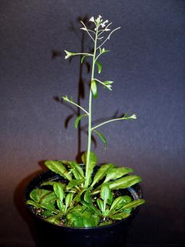

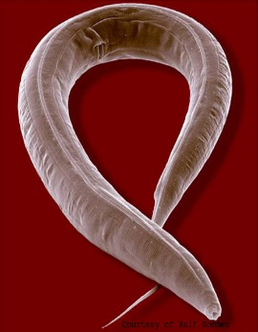

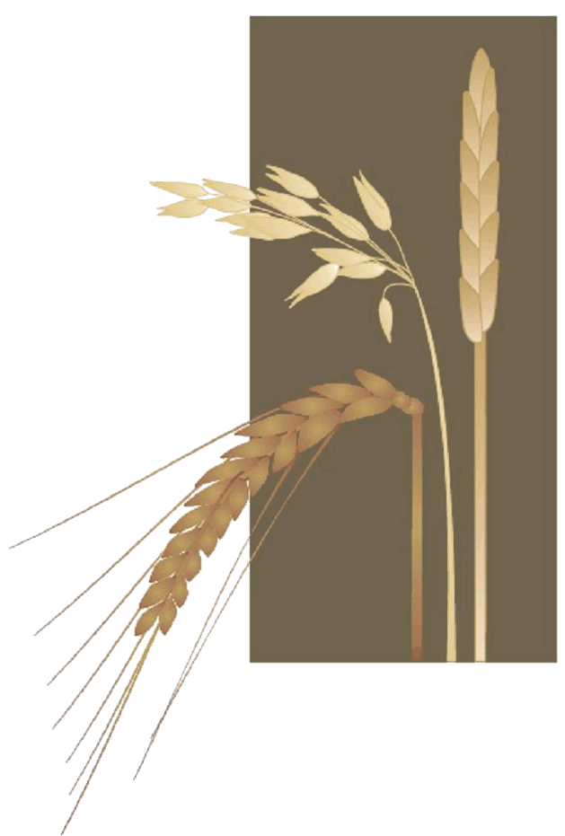
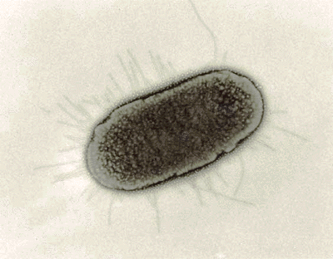
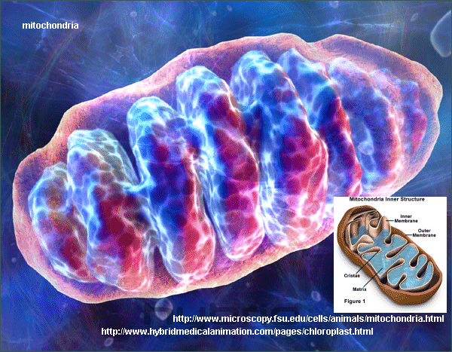
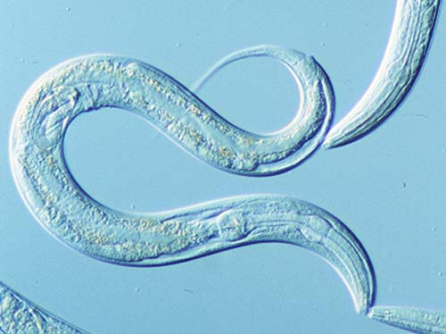
Thank You !

